Slide 1
MANAGING PUBLIC CONVERSATIONS & CONTROVERSY
Todd Pugh
Instructor, Capilano University &
Executive Director, CivicInfo BC

Slide 2

This is me, 2017.
My hair is not photoshopped,
but it is thin.

Slide 3

25 years as the Executive Director of CivicInfo BC, a non-profit information agency.
18 years as a sessional instructor, Local Government Programs, Capilano University.

Slide 4
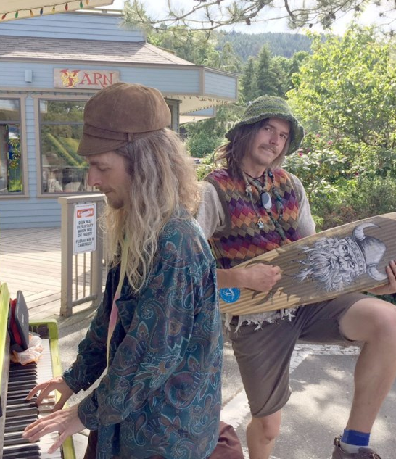
I live on the coast of British Columbia.
Some places look like this.

Slide 5

And some places
look like this.

Slide 6

BC was not always my home. I’m originally a farm kid from rural Southwestern Ontario.

Slide 7


Slide 8

Runaway dog.
Maximum distance from origin & still visible in Beaumont, Alberta.
My dog. Still visible.
Chatham, Ontario.
I love visiting Alberta, Saskatchewan, and Manitoba.
It’s very familiar, although there are minor differences.

Slide 9
Growing up, I received two important pieces of advice from local farmers.

Slide 10

Be outstanding
in your field.

Slide 11

Listening mends fences better than wire.

Slide 12
Today, we’re going to talk about listening as one strategy to deal with weird conversations like these…

Slide 13

“My opponent is giving away free coffee at his campaign event.
This is vote buying! Make him stop!”

Slide 14

“Do you guys use those electronic vote counting units? I’ve got an airplane…”

Slide 15

“Got a minute to talk? I’m going to tell you what I think about the Mayor and Council!”

Slide 16
AGENDA
We’re going to discuss tips for three types of public conversations:
Surviving the Online Swamp
In-Person / In-Your-Face Conversations
Managing Ongoing Controversies
A group exercise will follow each module.

Slide 17

SURVIVING THE ONLINE SWAMP

Slide 18
Prevention
(How to not get stuck in the swamp.)

Slide 19

ONLINE PREVENTION TIP #1
Have a Social Media Policy … and Stick to It!
A clear, publicly posted social media policy empowers you to moderate comments or block users who violate community standards (e.g., hate speech, harassment).

Slide 20

ONLINE PREVENTION TIP #2
Monitor, Don’t Patrol
Be aware of online conversations in the community, but don’t feel the need to intervene in every post.
Monitoring helps identify emerging issues without escalating conflict.

Slide 21

ONLINE PREVENTION TIP #3
Build a Relationship First, Before The Crisis
Use quiet times to post helpful, neutral, or engaging content.
Building trust and credibility with the public now helps when controversy strikes later.

Slide 22

ONLINE PREVENTION TIP #4:
Know When Not to Engage
It’s okay to let some posts go.
If a comment is aggressive, sarcastic, or clearly meant to provoke, it may be best left unanswered.
Others may take it on themselves to correct misinformation.

Slide 23

ONLINE PREVENTION TIP #5:
Don’t Take Attacks Personally
Anger is rarely about you as an individual. They may be frustrated with your organization or Council.
Anger can be misdirected. The issue might be provincial, federal or something completely different.
Always stay professional and don’t take it personally.

Slide 24
Actions
(What to do once you’re in the swamp.)

Slide 25

ONLINE ACTION TIP #1:
Respond Strategically, Not Emotionally
If you DO respond to a post, avoid getting drawn into back-and-forth arguments.
Choose your responses carefully and only engage when a correction or clarification adds real value.

Slide 26

ONLINE ACTION TIP #2:
Acknowledge Emotion Without Escalating
Sometimes, people want to be heard more than they want answers.
A simple “We hear your concerns” can go a long way, even before the facts are introduced.

Slide 27

ONLINE ACTION TIP #3:
Use “One to Many” Responses
If the same misinformation is being repeated, consider a single post or infographic shared to the broader group, rather than replying to each individual user.

Slide 28

ONLINE ACTION TIP #4:
Calmly Correct Misinformation with Facts
If you need to respond, focus on correcting false information with simple, factual language.
Avoid sounding defensive.
Whenever possible, link to official sources. (Like this Fact Book.)

Slide 29

ONLINE ACTION TIP #5:
Know When to Get Help
If a post includes threats, legal accusations, or goes viral in a damaging way, don’t handle it alone.
Work together with the appropriate members team, your legal counsel, you Council, and others (e.g., a communications professional).

Slide 30
GROUP EXERCISE #1 – ONLINE DISCOURSE
In small groups, discuss ONLINE DISCOURSE that you’ve experienced or witnessed. Pick one interaction as a “case study”, and reflecting on the 10 tips you’ve just received, discuss:
What was handled well?
What could have been handled differently to achieve a better outcome?
Were any other strategies used, and did they work?
Pick a scribe to take notes, and a spokesperson to speak for your group.

Slide 31
Summary
PREVENTION
Have a Social Media Policy
Monitor, Don't Patrol
Build Relationships Before a Crisis
Know When Not to Engage
Don't Take Attacks Personally
ACTIONS
"One To Many" Responses
Acknowledge Emotion w/o Escalating
Respond Strategically, Not Emotionally
Calmly Correct Misinformation
Know When to Get Help

Slide 32
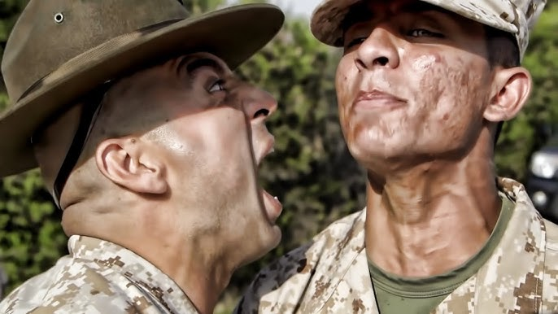
In-Person / In Your Face CONVERSATIONS

Slide 33

CONVERSATION TIP #1
Stay Calm & Grounded
Maintain a steady, calm tone of voice and body language. Your composure can de-escalate a situation more effectively than your words..

Slide 34
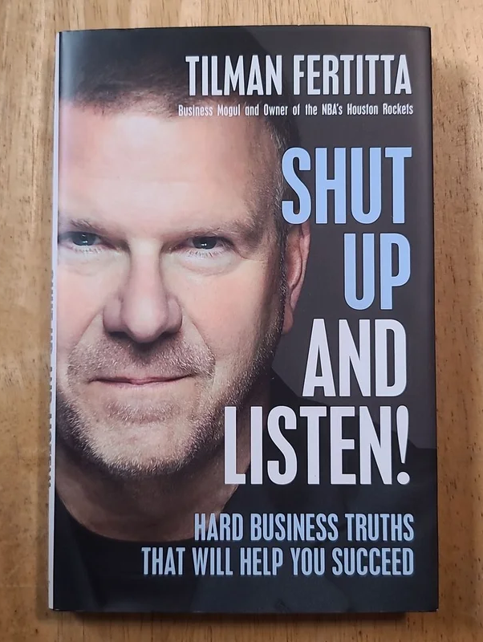
CONVERSATION TIP #2
Listen First, Speak Second
Let the person speak without interruption.
Often, simply allowing them to vent respectfully can defuse tension before you need to say anything.

Slide 35

CONVERSATION TIP #3
Acknowledge Emotion Without Agreeing
Statements like “I can see this is really frustrating for you” show empathy without conceding a point or accepting misinformation.

Slide 36

CONVERSATION TIP #4:
Stick to the Facts
Gently but clearly correct false information using verifiable facts.
Using phrases like “I understand that…” or “Our records show…” can sometimes help you stay neutral and credible.

Slide 37
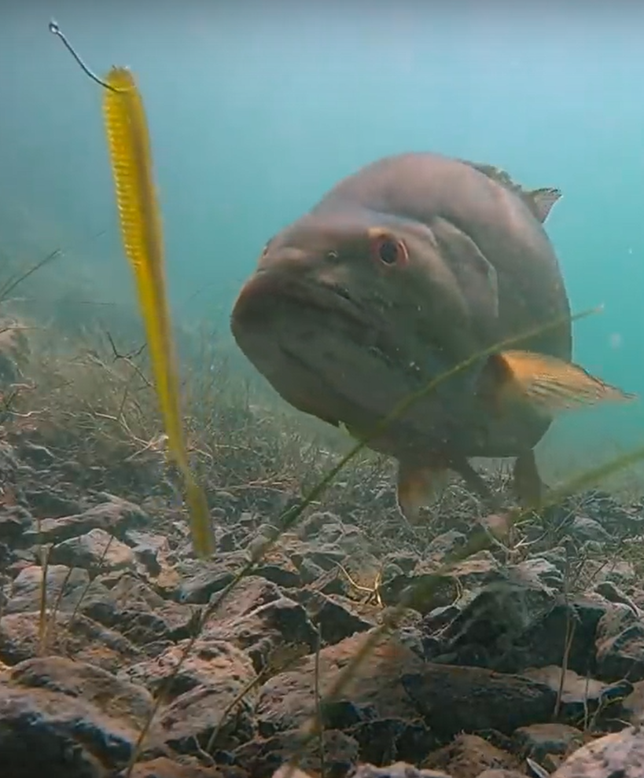
CONVERSATION TIP #5:
Don’t Take The Bait
If someone is trying to provoke you - through sarcasm, insults, or shouting - resist the urge to match their tone.
Stay professional and measured.

Slide 38

CONVERSATION TIP #6:
Set Boundaries Respectfully
If conduct becomes abusive or disruptive, calmly state your expectations: “I’m happy to continue this conversation, but I need you to speak respectfully.”

Slide 39

CONVERSATION TIP #7:
Bring in a Second Person When Needed
When possible, have another staff member present - both for support and as a witness if things escalate.

Slide 40
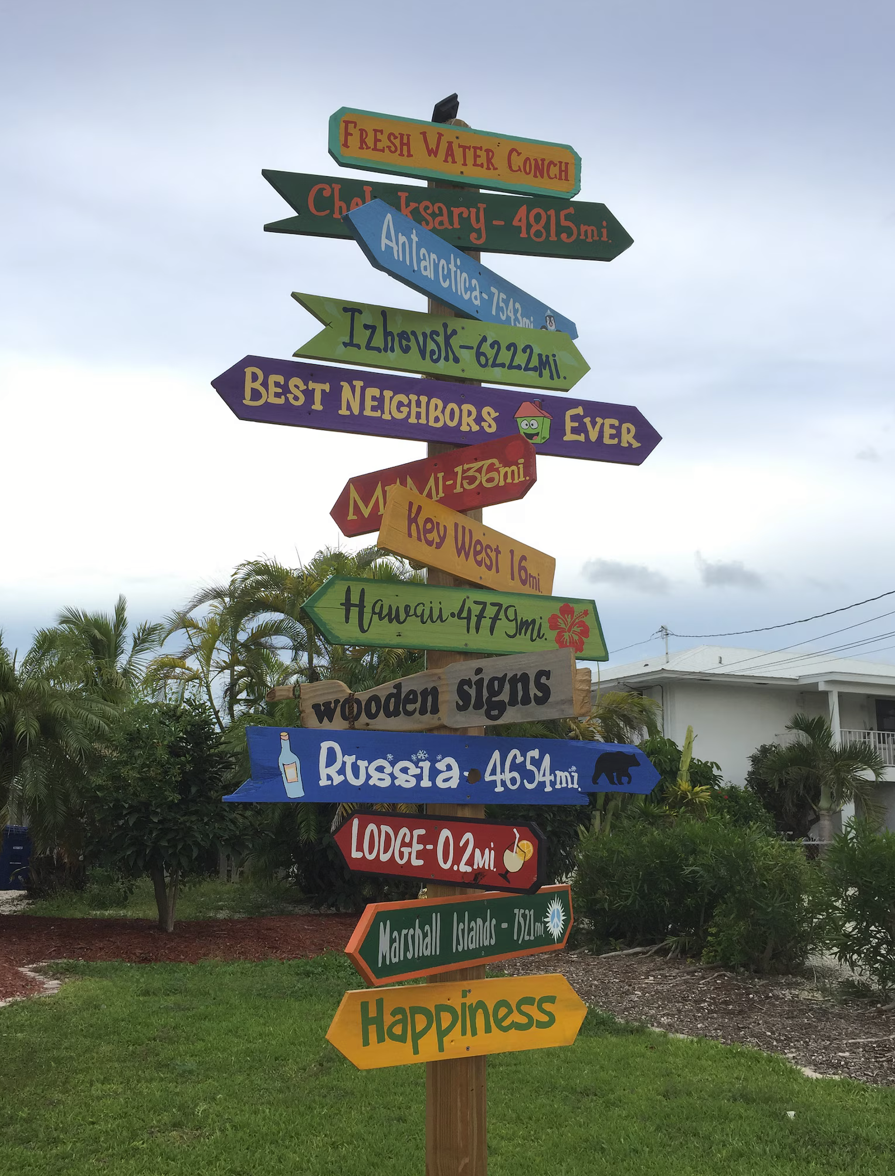
CONVERSATION TIP #8:
Redirect to Constructive Channels
If someone is demanding change or action beyond your role, explain the proper process: “The best way to raise that concern is by attending a council meeting, or submitting a formal complaint.”

Slide 41

CONVERSATION TIP #9:
Don’t Be Afraid to Pause or Walk Away
If someone is yelling, refusing to calm down, or creating an unsafe environment, it’s okay to step away or call for help. Safety comes first.

Slide 42

CONVERSATION TIP #10:
Debrief After
After a difficult interaction, take a few minutes with a colleague to decompress, share what happened, and document the incident if needed. It helps with stress and improves the team’s ability to handle future incidents.

Slide 43
GROUP EXERCISE #2 – CONVERSATIONS
In small groups, discuss DIFFICULT IN-PERSON CONVERSATIONS that you’ve experienced or witnessed. Pick one conversation as a “case study”, and reflecting on the 10 tips you’ve just received, discuss:
What was handled well?
What could have been handled differently to achieve a better outcome?
Were any other strategies used, and did they work?
Pick a scribe to take notes, and a spokesperson to speak for your group.

Slide 44
Summary
IN-PERSON INTERACTIONS
Stay Calm and Grounded
Listen First; Speak Second
Acknowledge Emotion w/o Agreeing
Stick to the Facts
Don't Take the Bait
Set Boundaries Respectfully
Bring in a Second Person
Redirect to Constructive Channels
Don’t be Afraid to Pause or Walk Away
Debrief After

Slide 45
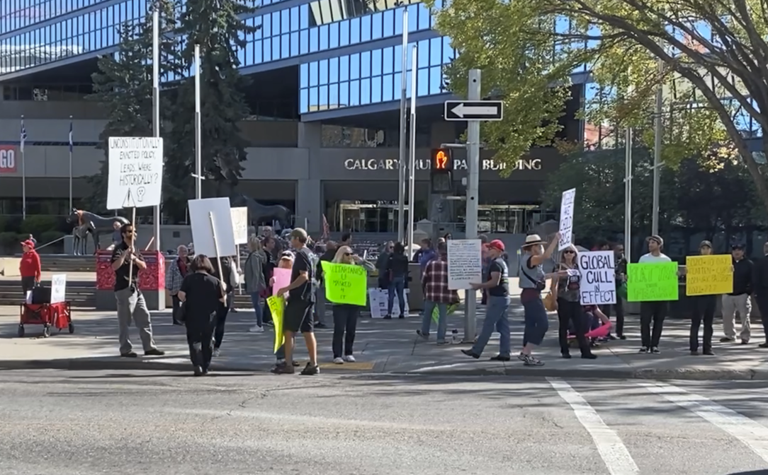
Managing Controversies

Slide 46

MANAGING CONTROVERY TIP #1
Lead with Transparency
Be open about what’s happening, what’s known, and what’s still being decided. Avoid hiding behind jargon or vague statements.
Message: “We know this is an important issue for many people. That’s why we’re committed to sharing accurate, timely information as decisions are made.”

Slide 47

MANAGING CONTROVERSY TIP #2
Name the Emotion
Acknowledge that people are upset. It’s humanizing and shows you’re not ignoring their experience.
Message: “We understand that this issue has raised strong feelings in our community—and that people are worried, angry, or uncertain.”.

Slide 48

MANAGING CONTROVERSY TIP #3: Stick to Process
Stick like glue to due process! Reinforce that there’s a clear, fair, and legal decision-making process underway.
Message: “We’re following the same public process that applies to all decisions like this, including public input, expert review, and council deliberation.”

Slide 49

MANAGING CONTROVERSIES TIP #4 Communicate Early & Often
Silence breeds suspicion. Even if there’s no new update, say so.
Message: “There are no new decisions today, but we’ll continue to keep the public informed through our website, newsletters, and social media.”

Slide 50

MANAGING CONTROVERSIES TIP #5:
Clarify What You Can and Cannot Control
Be clear about your role. You may be a messenger, not a decision-maker.
Message: “My role is to make sure decision-makers have the right information - and that your voices are heard as part of that process.”

Slide 51

MANAGING CONTROVERSIES TIP #6: Facilitate, Don’t Debate
Avoid one-on-one arguments. Create space for community dialogue instead.
Message: “Let’s make sure everyone has a chance to be heard. There are a number of ways to provide input, and we’ll ensure it’s all documented for council.”

Slide 52

MANAGING CONTROVERSIES TIP #7: Use “We” More Than “You” or “They”.
Avoid sounding adversarial or blaming. Frame the issue as a shared challenge.
Message: “We all want what’s best for our community, even if we have different views on how to get there.”

Slide 53

MANAGING CONTROVERSIES TIP #8: Don’t Guess. Say You’ll Check.
If you don’t know something, don’t improvise.
Message: “That’s a good question, and I want to make sure I give you an accurate answer. I’ll look into it and get back to you.”

Slide 54

MANAGING CONTROVERSIES TIP #9: Focus on Interests, Not Positions
Angry people often take rigid positions. Try to uncover the underlying interests or values.
Asking others “What’s most important to you in this situation?” can shift the conversation away from confrontation.

Slide 55

MANAGING CONTROVERSIES TIP #10:
Take Care of Yourself and Your Team
Controversy can burn people out. Support each other, and step away when needed.
Message (internally): “This is a tough situation. Let’s be sure we’re checking in with each other, and sharing the load.”

Slide 56
Group Exercise #3

Slide 57
GROUP EXERCISE #3
In small groups, discuss PUBLIC CONTROVERSIES that you’ve experienced or witnessed. Pick one controversy as a “case study”, and reflecting on the 10 tips you’ve just received, discuss:
What was handled well?
What could have been handled differently to achieve a better outcome?
Were any other strategies used, and did they work?
Pick a scribe to take notes, and a spokesperson to speak for your group.

Slide 58
Summary
MANAGING CONTROVERSIES
Lead with Transparency
Stick to Process
Communicate Early & Frequently
Stick to the Facts
Clarify What You Can Control
Facilitate; Don’t Debate
Use “We” Instead of “You” / “They”
Don’t Guess, Say You’ll Check
Focus on Interests, not Positions
Take Care of Yourself and Your Team

Slide 59


Todd Pugh Instructor, Capilano University & Executive Director, CivicInfo BC tpugh@civicinfo.bc.ca

